Slide 1
Secure Mobile Development with NetIQ Access Manager

Slide 2
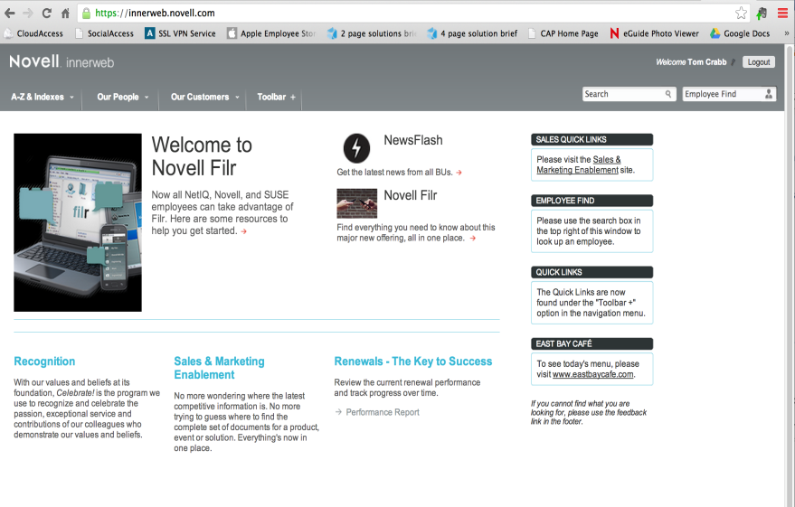
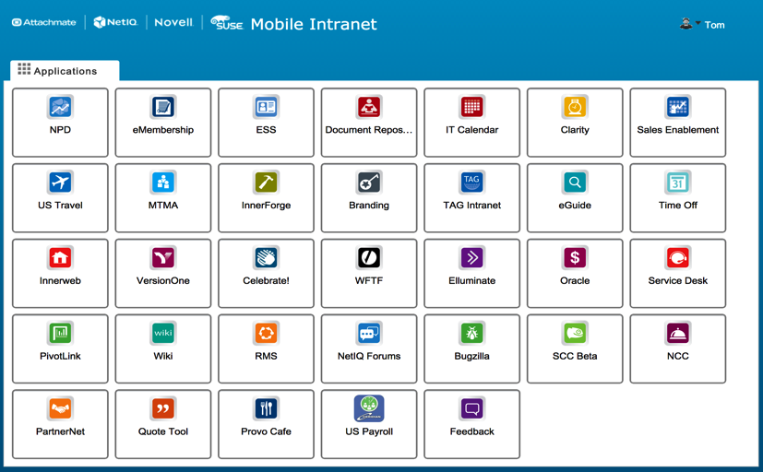
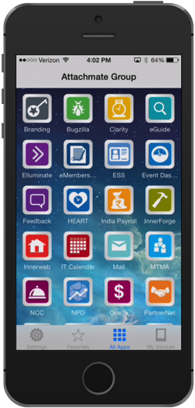
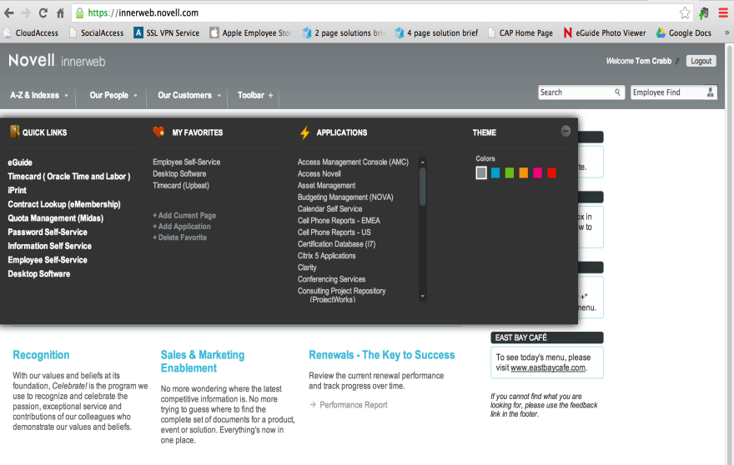
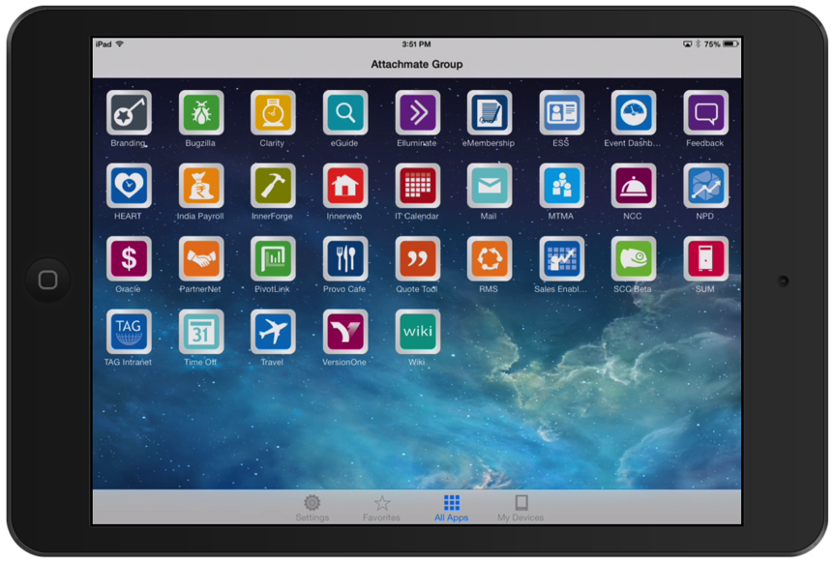
Changing User Expectations
Improving and extending access management
Intranet / One Big App
Driven by IT
Tablet / Individual Apps
Driven by Users

Slide 3

The Mobile Challenges
  BYOD presents new risks and opportunities
  Should I develop new apps ?
  What about legacy systems ?
  How do I manage authentication and access control ?
  How do I manage user enrollment ?
  What about lost devices ?
  What about SSO between apps ?

Slide 4
Access manager Mobility support

Slide 5
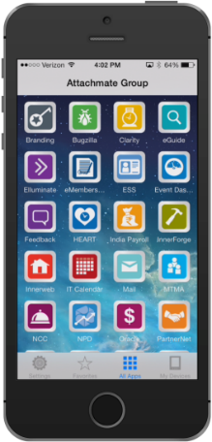
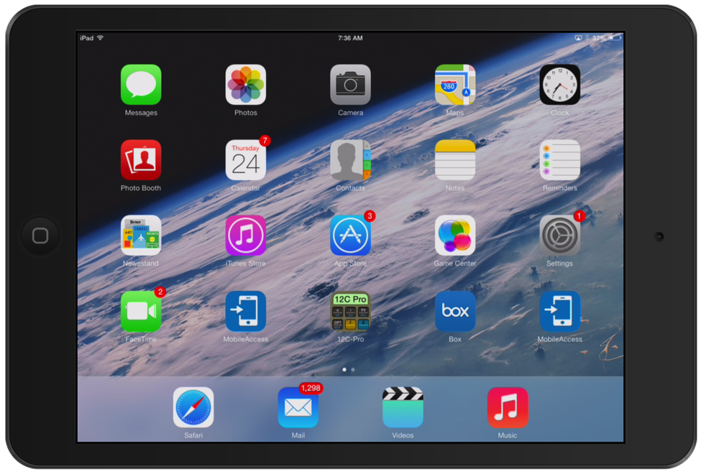
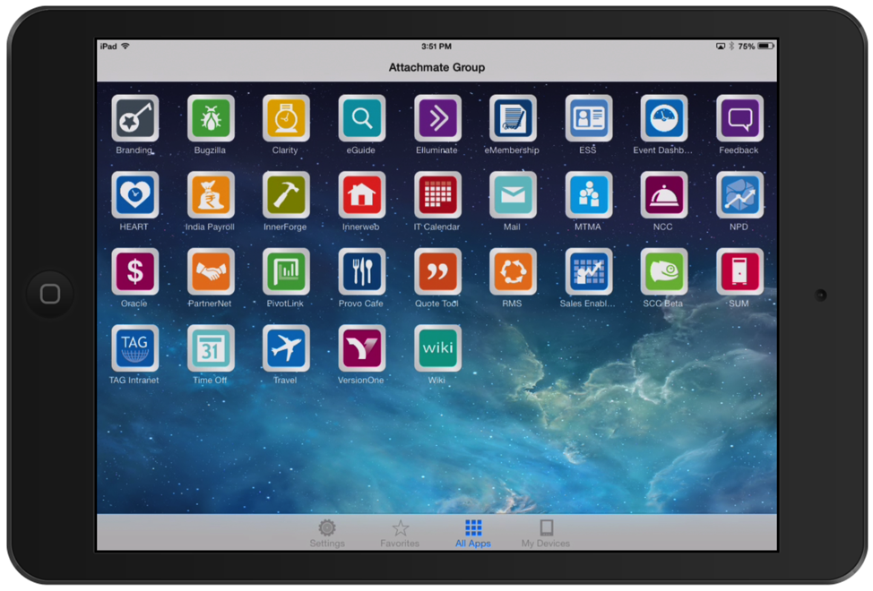
Mobile Access
Brings ease of use to the mobile owner and administrator
Gives a mobile view of the corporate resources
Reduces risk of lost or stolen devices
Keeps corporate password off of the mobile device
Delivered as an App

Slide 6
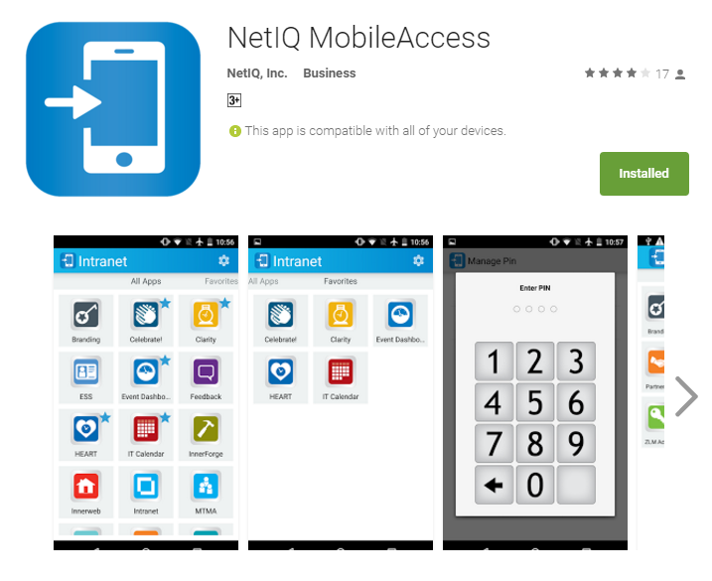
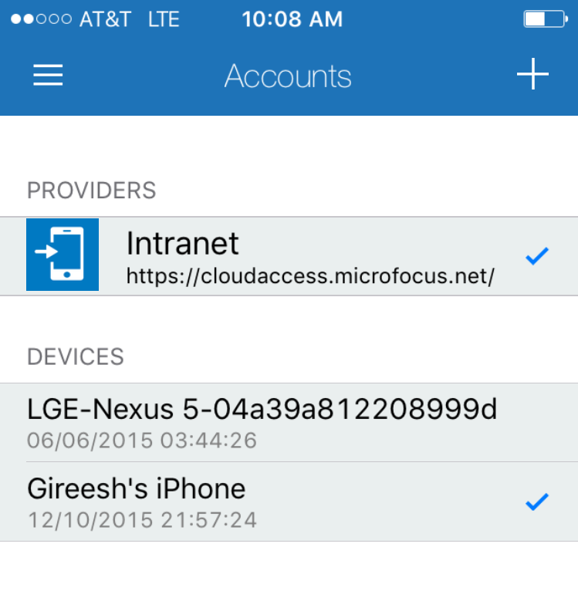
MobileAccess
Native Mobile App
Native Mobile App
Container for ‘AppMarks’
Role-based access
Built-in security
  No passwords in the device
  Tokens stored in secure keychain
  PIN protection
User self-service

Slide 7
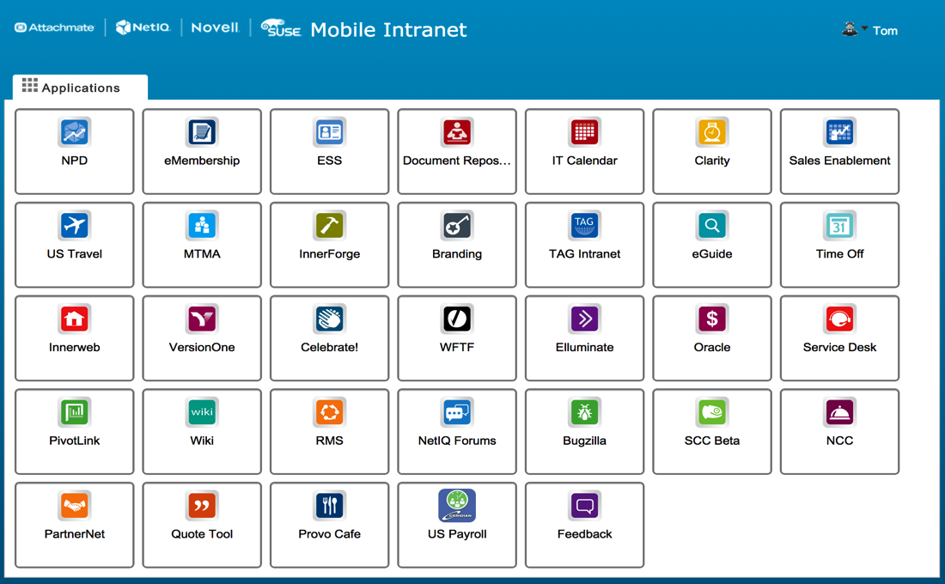
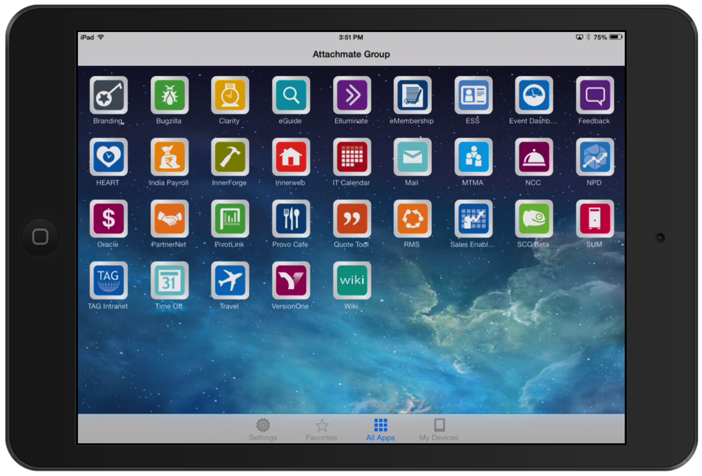
Mobile Access
HTML Landing Page
Desktop View
Mobile Device View
of Applications

Slide 8
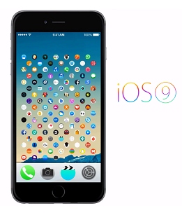
Native Mobile Application Development
Option 1
  SDK for developing native mobile app
  SDK for iOS
  Android SDK in development
Option 2
  OAuth/OpenID Connect
  Supports full-stack OAuth2.0 protocol
  Role based access control
  Application and device registration support

Slide 9
Native Application Development – Option 1
Mobile Development SDK

Slide 10
SDK for native iOS Apps
Library in Objective-C
Simple APIs with drop-in solution
  no source code needed to be included in developer project
Supported Platforms – iOS 8+
Achieve 1-prompt SSO to OAuth resources
TestApp to test SDK
Sensitive data such as Access, Refresh Tokens are securely stored in device Keychain

Slide 11
iOS SDK
SDK available as iOS Framework
  To be dropped in Xcode project
  Add NMAAuthLib.framework file in appropriate build Target to the Embedded Binaries section
  Two separate deliverables, one for simulator & other for the device
Implements the [native application profile] of OAuth spec http://tools.ietf.org/html/rfc6749
All communications are over HTTPS
Handles Multiple Accounts
Special Redirect URI for Embedded browser
urn:ietf:wg:oauth:2.0:oob

Slide 12
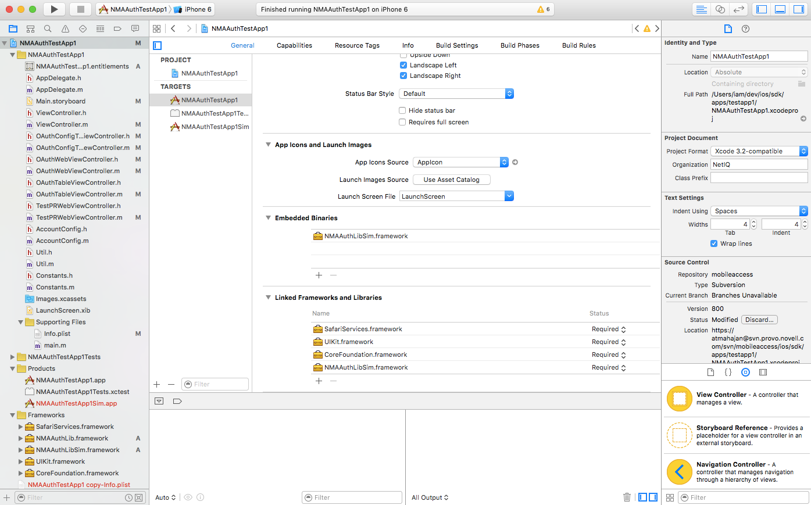

Slide 13
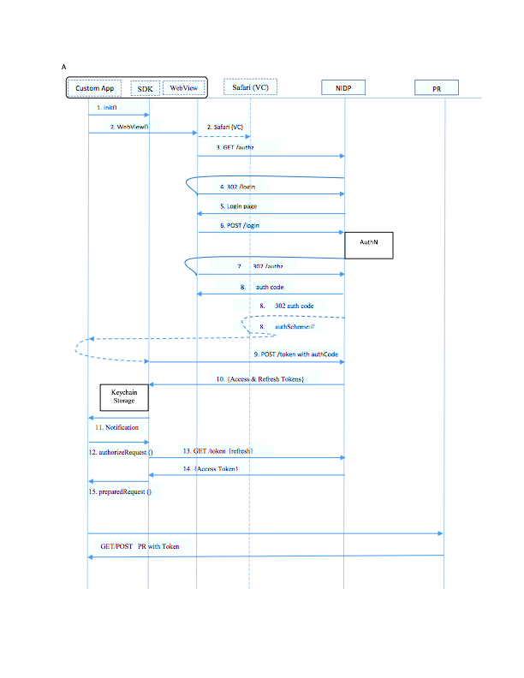
SDK – Sequence of actions

Slide 14
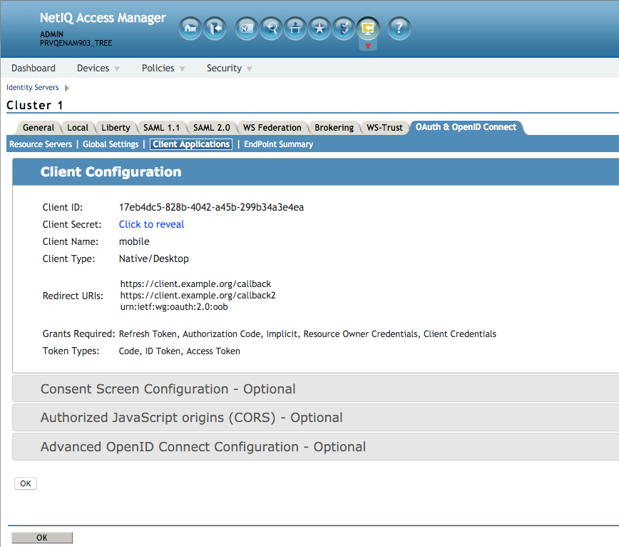
OAuth Configuration
OAuth scopes can be configured in NAM OAuth settings -> Resource Servers -> scopes
Sample OAuth application configuration shown below

Slide 15
Using NMAAuthLib
Configure your Client
- NMAAuthLibManager Singleton
[[NMAAuthLibManager sharedInstance] setClientID:@"myClientID" secret:@"mySecret" authorizationURL:[NSURL URLWithString:@"https://your authz URL..."] tokenURL:[NSURL URLWithString:@"https://your token URL..."] redirectURL:[NSURL URLWithString:@"https://your redirect URL..."] forAccountName:@"myOAuth2Service"];
Requesting Access
- Embedded Browser - Provide Authorization URL Handler
[[NMAAuthLibManager sharedInstance] signInToAccountWithName:@"myOAuth2Service" withPreparedAuthorizationURLHandler:^(NSURL *preparedURL){ // Open a web view or similar }];
- Load request in WebView
[_webView loadRequest:[NSURLRequest requestWithURL:preparedURL]];
- In webViewDidFinishLoad delegate method parse the callback URL
One of the possible places server can send the Authorization Code is Page Title
[NMAAuthLibManager handleRedirectURL:]
- On Success
After successful authentication, a new NMAAuthAccount is created and stored in device keychain and your app will receive `NMAAuthAccountManagerAccountsDidChangeNotification’ notification
- On Failure
If Authentication failed, `NMAAuthAccountManagerDidFailToRequestAccessNotification` notification containing an `NSError` will be sent.

Slide 16
Using NMAAuthLib
Getting Accounts
- List of all account or specific account can be queried by
[[NMAAuthLibManager sharedInstance] accountsWithAccountName:@"myOAuth2Service"]
Invoking a Protected Resource Request
There are a couple of ways to invoke a request. The preferred way is to pre-authorize the request. This will pre-emptively refresh token if the access token has expired (within 60 secs)
[theRequest authorizeRequestWithError:&error];
Note: This is a synchronous call and is made on the calling method thread.
User Data
- Each NMAAuthAccount has a property ‘userData’ which can be used to store account user information
Removing Accounts
- [[NMAAuthLibManager sharedInstance] removeAccount:account];

Slide 17
Native Application Development – Option 2
OAuth and OpenID Connect

Slide 18
What is OAuth?
An open protocol standard(s) for Web API authorization
Goals:
  OAuth provides a method for users to grant third party access to resources without sharing credentials
  OAuth allows users to exchange tokens instead of credentials to their data hosted by a service
  Allows to control access by
    Scope, Action, Time

Slide 19
OpenID Connect
A simple identity protocol built on top of OAuth 2.0
Allows Clients to verify the identity of the End-User based on the authentication performed by an Authorization Server
Allows clients to obtain basic profile information about the end-user in an interoperable and REST call
Notes:
ID Token
Userinfo endpoint
Tokeninfo endpoint
Claims request

Slide 20
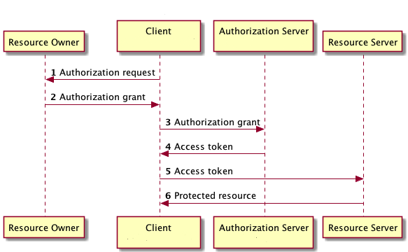
Typical OAuth flow
Notes:
The authorization code grant starts with the client, such as a web-based service, redirecting the resource owner's user-agent to the authorization service (IDP). After authenticating the resource owner again obtaining the resource owner's authorization, IDP redirects the resource owner's user-agent back to the client with an authorization code that the client uses to request the access token. The following sequence diagram outlines a successful process from initial client redirection through to the client accessing the protected resource.
The implicit grant is designed for clients implemented to run inside the resource-owner user agent. Instead of providing an authorization code that the client must use to retrieve an access token, IDP returns the access token directly in the fragment portion of the redirect URI.
The resource owner password credentials grant lets the client use the resource owner's user name and password to get an access token directly. Although this grant might seem to conflict with an original OAuth goal of not having to share resource owner credentials with the client, it can makes sense in a secure context where other authorization grant types are not available, such as a client that is part of a device operating system using the resource owner credentials once and thereafter using refresh tokens to continue accessing resources
The client credentials grant uses client credentials as an authorization grant. This grant makes sense when the client is also the resource owner, for example.

Slide 21
OAuth/OpenID Connect support in NAM
NAM IDP would function as OAuth 2.0 authorization server
  IDP could authenticate resource owners, obtain their authorization and issue access token to client applications
  Provides ability to convert legacy applications to OAuth flow
NAM Access Gateway could authorize OAuth tokens and inject credentials to applications
  Provides ability to convert legacy applications to OAuth flow without modifications
Supports OAuth Flows such as
  Authorization code grants
  Implicit grants
  Resource Owner Credentials grant
  Client credential grants
Supports OpenID Connect endpoints
  JSON Web Tokens
  ID Token
  Userinfo endpoint
  Tokeninfo endpoint
  Claims requests
Notes:
The authorization code grant starts with the client, such as a web-based service, redirecting the resource owner's user-agent to the authorization service (IDP). After authenticating the resource owner again obtaining the resource owner's authorization, IDP redirects the resource owner's user-agent back to the client with an authorization code that the client uses to request the access token. The following sequence diagram outlines a successful process from initial client redirection through to the client accessing the protected resource.
The implicit grant is designed for clients implemented to run inside the resource-owner user agent. Instead of providing an authorization code that the client must use to retrieve an access token, IDP returns the access token directly in the fragment portion of the redirect URI.
The resource owner password credentials grant lets the client use the resource owner's user name and password to get an access token directly. Although this grant might seem to conflict with an original OAuth goal of not having to share resource owner credentials with the client, it can makes sense in a secure context where other authorization grant types are not available, such as a client that is part of a device operating system using the resource owner credentials once and thereafter using refresh tokens to continue accessing resources
The client credentials grant uses client credentials as an authorization grant. This grant makes sense when the client is also the resource owner, for example.

Slide 22
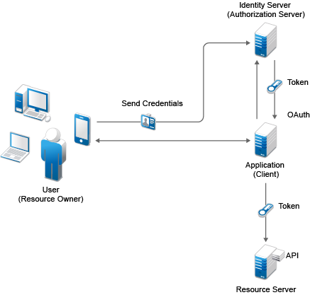
Web Application Validation Method
Identity Server issues the Access token
Web Applications validate the token
Notes:
Web applications validate an Access token before allowing a client application to access resources
The Identity Server (authorization server) issues an Access token and web applications validate the token before granting a client application to access resources. This configuration is suitable in the following scenarios:
Web server authentication
Accessing resources without using owner’s credentials
RESTful applications security
Mobile authentication
The client application requests authorization from the user (resource owner). Client applications can make the authorization request directly to the resource owner or through the authorization server (Identity Server) as an intermediary.
The client application receives an authorization grant from the authorization server. An authorization grant represents the resource owner's authorization. The user communicates the authorization by using one of four grants types or by using an extension grant.
The client application authenticates itself at the authorization server, sends the authorization grant, and requests an Access token.
The authorization server authenticates the client application and validates the authorization grant. The authorization server issues an Access token for a valid grant.
The client application requests the resource server to provide access to the protected resource and authenticates this by presenting the Access token.
The resource server accepts the request for a valid token.

Slide 23
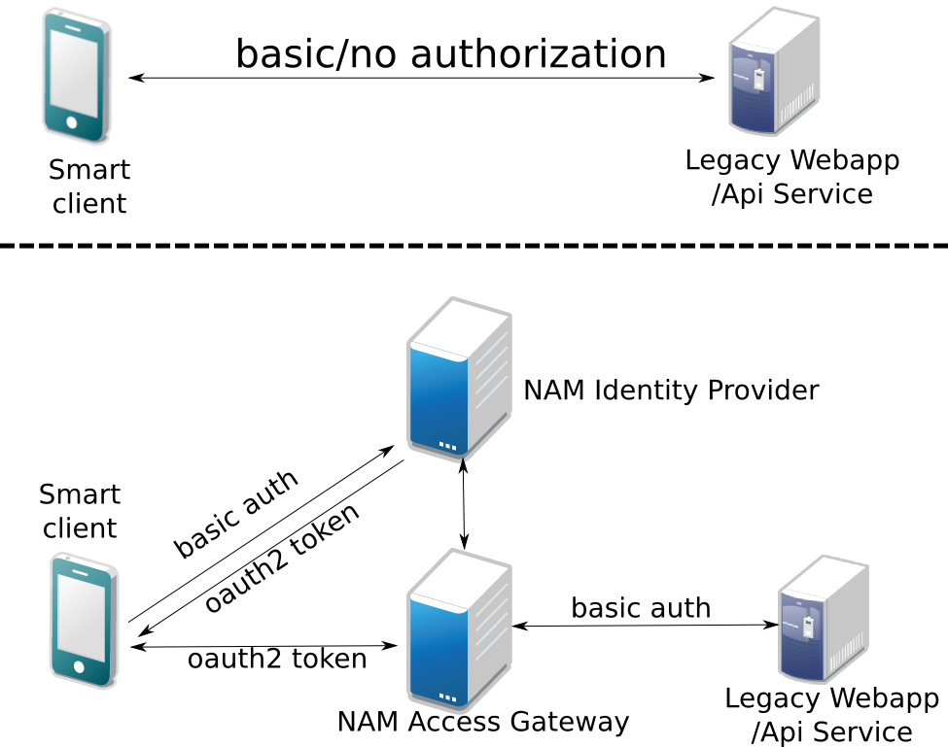
OAuth support in NAM Access Gateway

Slide 24
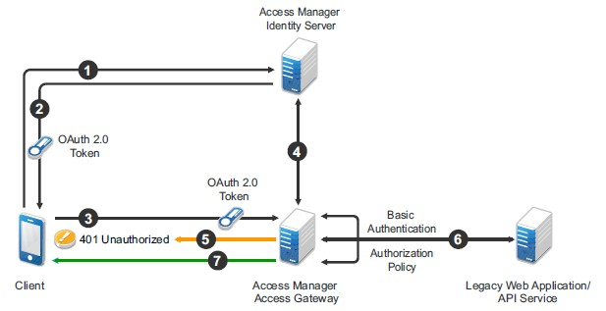
Access Gateway Validation Method
Used for access to legacy web applications
Notes:
This configuration is suitable when client applications want to access resources on legacy web applications.
A client application requests access to a web resource and provides authentication details to the Identity Server.
The Identity Server authenticates the client application, gets the user’s consent, generates an OAuth token, and sends the token to the client application.
The client application provides the token to the Access Gateway.
The Access Gateway sends the token to the Identity Server for validation.
If the token is not valid, AG returns a 401 error.
If the token is valid, The Access Gateway performs the following tasks:
Executes the authorization policy, if configured, based on OAuth scopes or claims.
Sends user attributes and grants details provided to the client application to the web application by using the Identity Injection policy, if configured.
The resource server returns a response to the Access Gateway and the Access Gateway sends this response to the client application.

Slide 25
Configuring OAuth with OpenID Connect
To configure OAuth and OpenID Connect:
Enable the OAuth protocol in the Administration Console
Define the global settings
Configure a resource server
Configure scopes and claims for a resource server
Register client applications
More information about each step is in the Administration Guide.

Slide 26
Embracing Mobility
What to choose when?
Mobile Access | Mobile SDK | OAuth/OIDC | SAML
For extending existing applications to mobile | When developing native mobile apps | When developing native mobile apps and securing APIs (primarily RESTful APIs) | For federation to SAML enabled web applications
Quick configuration, no developer experience required | Requires developer experience, more functional and easier that handling protocols | Flexible, requires understanding of technology, much broader than mobile use cases | Easier configuration with NAM, no developer experience required
May not be as functional and user friendly as native apps | Allows faster development of native app authentication | More flexible and generic, supports complex use cases | More suited for web federation

